Slide 1
Software Testing and Quality Assurance
Haiming Liu
liuhaiming@bjtu.edu.cn
School of Software Engineering
Beijing Jiaotong University

Slide 2
Black-box Testing
Random Testing
Equivalence Partitioning
Boundary Value Analysis
Cause-Effect Analysis
Error Guessing
STATE TESTING

Slide 3
Cause-Effect Analysis
Cause-Effect Analysis is a systematic means for generating test cases to cover different combinations of input ‘‘Causes’’ resulting in output ‘‘Effects.’’
A CAUSE may be thought of as a distinct input condition, or an ‘‘equivalence class’’ of input conditions.
An EFFECT may be thought of as a distinct output condition, or a meaningful change in program state.
Causes and Effects are represented as Boolean variables and the logical relationships among them CAN (but need not) be represented as one or more boolean graphs.
Notes:
因果分析

Slide 4
Cause-Effect Analysis
Black-box technique to analyze combinations of input conditions
Identify causes and effects in specification ↓ ↓ inputs outputs current state new state
Make Boolean Graph linking causes and effects
Annotate impossible combinations of causes and effects
Develop decision table from graph with in each column a particular combination of inputs and outputs
Transform each column into test case
Notes:
分析输入条件组合的黑盒技术
确定规范中的原因和影响

Slide 5
C-E Analysis Process Steps
Cause-effect analysis consists of the following 5 steps
Division of specification
Identification of cause and effects
Transforming the specifications into a cause-effect graph
Conversion into decision table:
Deriving test case
Notes:
1.规格划分：
。
2.确定因果关系：
。
3.将规格转换为因果图：
。
4.转换为决策表：
。
5.导出测试用例：

Slide 6
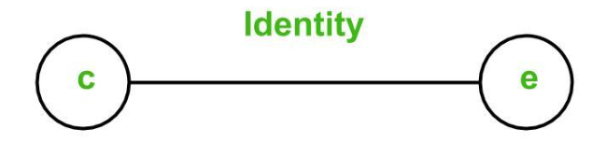
Basic Notations used in C-E Graph
Here c represents cause and e represents effect.
The following notations are always used between a cause and an effect:
Identity Function: if c is 1, then e is 1. Else e is 0.
Notes:
恒等

Slide 7
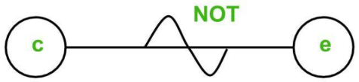
Basic Notations used in C-E Graph
NOT Function: if c is 1, then e is 0. Else e is 1.

Slide 8
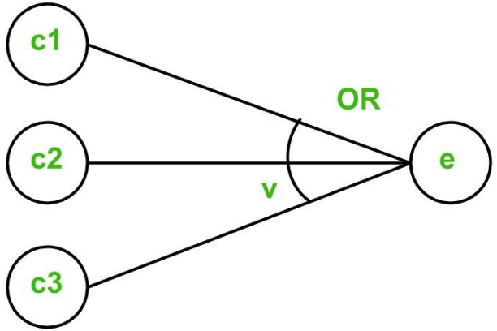
Basic Notations used in C-E Graph
OR Function: if c1 or c2 or c3 is 1, then e is 1. Else e is 0.

Slide 9
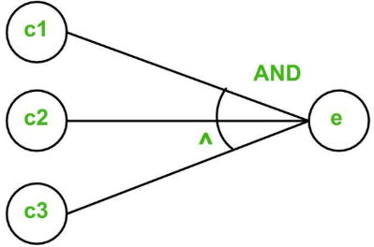
Basic Notations used in C-E Graph
AND Function: if both c1 and c2 and c3 is 1, then e is 1. Else e is 0.

Slide 10
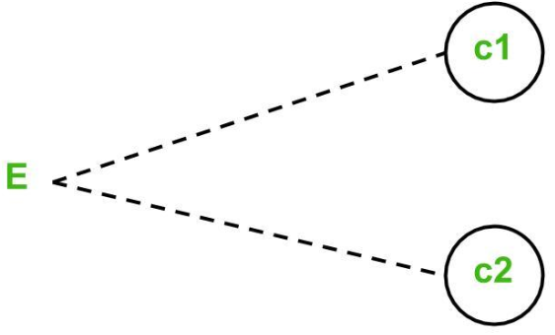
Basic Notations used in C-E Graph
To represent some impossible combinations of causes or impossible combinations of effects, constraints are used.
The following constraints are used in cause-effect graphs:
Exclusive constraint or E-constraint: This constraint exists between causes. It states that either c1 or c2 can be 1, i.e., c1 and c2 cannot be 1 simultaneously.
Notes:
原因之间，结果之间也是有可能存在的条件约束的。
为了表示一些不可能的原因组合或不可能的效果组合，使用了约束。因果图中使用了以下约束：

Slide 11
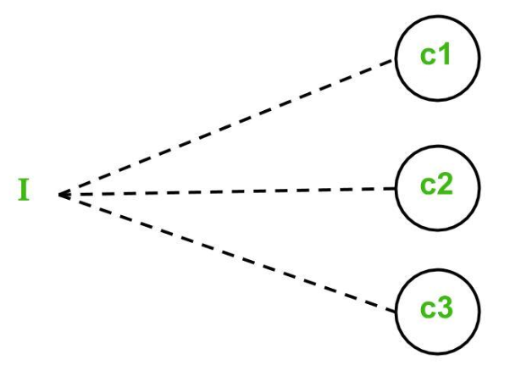
Basic Notations used in C-E Graph
Inclusive constraint or I-constraint: This constraint exists between causes. It states that atleast one of c1, c2 and c3 must always be 1, i.e., c1, c2 and c3 cannot be 0 simultaneously.
Notes:
包含约束或I-constraint

Slide 12
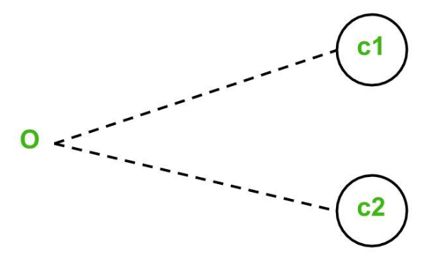
Basic Notations used in C-E Graph
One and Only One constraint or O-constraint: This constraint exists between causes. It states that one and only one of c1 and c2 must be 1.
Notes:
一个且仅一个约束或O约束

Slide 13
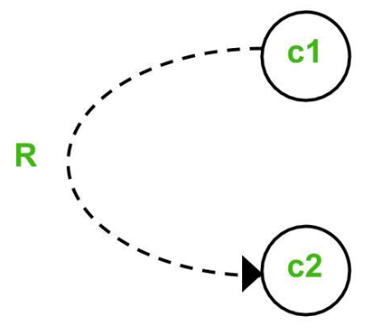
Basic Notations used in C-E Graph
Requires constraint or R-constraint: This constraint exists between causes. It states that for c1 to be 1, c2 must be 1. It is impossible for c1 to be 1 and c2 to be 0.
Notes:
要求约束或R约束。

Slide 14
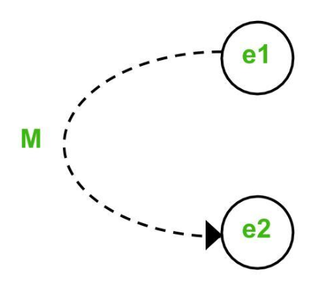
C-E Analysis
Mask constraint or M-constraint: This constraint exists between effects. It states that if effect e1 is 1, the effect e2 is forced to be 0.
Notes:
屏蔽约束或M约束

Slide 15
Identification of cause and effects
产品说明书：有一个处理单价为1元5角钱的盒装饮料的自动售货机软件。若投入1元5角硬币，按下“可乐”、“咖啡”、或“茶”按钮，相应的饮料就送出来。若投入的是2元硬币，在送出饮料的同时退还5角硬币。
Cause | C1:投入1元5角硬币
 | C2:投入2元硬币
 | C3:按下“可乐”
 | C4:按下“咖啡”
 | C5:按下“茶”
Effect | E1:退还5角硬币
 | E2:送出“可乐”
 | E3:送出“咖啡”
 | E4:送出“茶”

Slide 16
Identification of cause and effects
产品说明书：有一个处理单价为1元5角钱的盒装饮料的自动售货机软件。若投入1元5角硬币，按下“可乐”、“咖啡”、或“茶”按钮，相应的饮料就送出来。若投入的是2元硬币，在送出饮料的同时退还5角硬币。
Cause | C1:投入1元5角硬币
 | C2:投入2元硬币
 | C3:按下“可乐”
 | C4:按下“咖啡”
 | C5:按下“茶”
Middle | Cm1:已投币
 | Cm2:已按键
Effect | E1:退还5角硬币
 | E2:送出“可乐”
 | E3:送出“咖啡”
 | E4:送出“茶”

Slide 17
Conversion into decision table
 |  | 1 | 2 | 3 | 4 | 5 | 6 | 7 | 8 | 9 | 10 | 11
C | C1:投入1元5角硬币 | 1 | 1 | 1
 | C2:投入2元硬币 | 1 | 1 | 1
 | C3:按下“可乐” | 1 | 1 | 1
 | C4:按下“咖啡” | 1 | 1 | 0
 | C5:按下“茶” | 1 | 0 | 1
M | Cm1:已投币
 | Cm2:已按键
E | E1:退还5角硬币
 | E2:送出“可乐”
 | E3:送出“咖啡”
 | E4:送出“茶”

Slide 18
Deriving test case

Slide 19
Black-box Testing
Random Testing
Equivalence Partitioning
Boundary Value Analysis
Cause-Effect Analysis
Error Guessing
STATE TESTING

Slide 20
Error Guessing
Testers utilize intuition and experience to identify potential errors and design test cases to reveal them.
Guidelines:
Design tests for reasonable but incorrect assumptions that may have been made by developers.
Design tests to detect errors in handling special situations or cases.
Design tests to explore unexpected or unusual program use or environmental scenarios.
Notes:
根据测试人员以往的经验猜测可能出现问题的地方来进行用例设计的一种技术

Slide 21
Error Guessing
More sophisticated ‘error guessing’: Risk Analysis
Try to identify critical parts of program ( high risk code sections ):
parts with unclear specifications
developed by junior programmer while his wife was pregnant ……
complex code : measure code complexity - tools available (Logiscope,…)
High-risk code will be more thoroughly tested ( or be rewritten immediately ……)

Slide 22
STATE TESTING
All software flows from one state to another.
For some software, these state changes are obvious:
Paint Program
To determine states, we need to build a state transition diagram or state transition map.
Good requirements or specifications often include these.
There are software tools for drawing them.
Different diagramming techniques exist --- we’ll use just one, but it is not the only one possible.

Slide 23
Definition: State Transition Map
A STM is a graph showing the logic flow from state to state in the program. This is diagrammed using the symbols:
a state
the start state
a transition
All of these are labeled
States- to identify them
Transitions- to identify what triggers movement from one state to another state.

Slide 24
What the STM Shows
Each unique state of the software.
Input or condition needed to move from one state to the next.
What is set or what output is produced when a state is entered or exited.
Obviously, we can’t investigate all possible paths through the state transition map (this is really the “traveling salesperson problem”).

Slide 25
Use Equivalence Partitioning to Choose Test Cases for State Testing
Possible choices for partitioning:
Try to visit each state at least once.
Test the most common or popular state-to-state transitions.
Test the least common paths between states.
Test all entrances and exits from error states.
Test random state transitions --- i.e. throw darts a the transition state map!
All of these are testing-to-pass cases.

Slide 26
More on State Testing
Involves checking all state variables which define a state.
It is suggest that checking with the spec writers and programmers to identify possible states --- but, caution
DO NOT GO TO THE CODE LEVEL!
Programmers will tend to want to drag out code if it exists!

Slide 27
Testing-to-Fail State Testing
Check race conditions – a timing problem causes the execution to not proceed as planned.
Try interrupting the program in the middle of its execution as see what happens.
Is data lost?
Can the program be restarted in a clean condition?
Start two instances of the same program and input to both.
What happens?
Notes:
检查竞争条件 –时序错乱 导致执行无法按计划进行。

Slide 28
Repetition, Stress & Load Testing
Repetition testing can often find memory leaks --- memory not freed completely when it should be.
Stress testing tries to run under bad conditions --- low memory, slow CPU, etc.
Load testing overloads the program with huge data files, long periods of execution, etc.
Round all of this out by just playing like a dumb user! (But, call them an inexperienced user, please!)

Slide 29
Which One to Choose?
Black-box testing techniques :
Equivalence partitioning
Boundary value analysis
Cause-effect analysis
Error guessing
…………
Test derivation from formal specification, Which one to use ?
None of them is complete
All are based on some kind of heuristics
They are complementary
Notes:
黑盒测试技术：
等价划分
边值分析
因果图
错误猜测法…………

Slide 30
Which One to Choose?
Always use a combination of techniques
When a formal specification is available try to use it
Identify valid and invalid input equivalence classes
Identify output equivalence classes
Apply boundary value analysis on valid equivalence classes
Guess about possible errors
Cause-effect graphing for linking inputs and outputs
Notes:
一定要综合运用各种技巧当

Slide 31
16 Weeks Plan
Week 1: The basic concepts and theories of testing
Week 2-3: Principles of Testing
Week 4: Test Cases
Week 5-6: Black Box Testing
Week 7-9: White Box Testing
Week 10: Integration Testing and System Testing
Week 11: Usability Testing and Accessibility Testing
Week 12: Security Testing
Week 13: Mutation Testing
Week 14: Software Quality
Week 15: Review I
Week 16: Review II

Slide 32

White-box testing
In white-box testing, the software tester has access to the program’s code and can examine it for clues to help him with his testing—he can see inside the box. Based on what he sees, the tester may determine that certain numbers are more or less likely to fail and can tailor his testing based on that information.
It is also called glass box testing or clear box testing or structural testing.

Slide 33
TESTING FUNDAMENTALS EXAMINING THE CODE

Slide 34

Examine the Design Documents & Code
These are static, white box techniques.
Handling these requires some programming expertise.
It is best if the testers know the language in which the software is written.
Consequently, you often find these tests are run by either Programmers with software testers as observers or Software testers with help from the programmers.
Notes:
静态的白盒技术

Slide 35
Major Problems with These Tests
They are often NOT performed!
These are the hardest to justify to upper management as they are viewed by many as too time consuming.
Some of the problem is the perception that programmers are not productive if they are not generating code.
Note: The tyranny of the LOC metric, Lines of executable code as a measure of productivity!

Slide 36
REVIEWS
These are structured processes for doing static, white box testing.
4 elements are required:
1. Identify problems by directing attention to the code, not who wrote it.
2. Setup and follow rules for the review:
- How much code should be examined?
- How long should the review take?
- What is fair game for the review?
3. Prepare and assign duties to people
Moderator, recorder, reader, etc.
4. Write a report.
These are not just “get together and go over code” sessions!
Notes:
1.确定问题。
2.设置并遵循审核规则
3.准备
4编写报告。

Slide 37
REVIEWS
In addition to finding problems, holding formal reviews has a few indirect results:
Communications.
Quality
Team Camaraderie
Solutions.

Slide 38
Three approaches
Peer review
Walkthrough
Inspection
Informal
Formal
Peer Review Walkthrough Inspection
Notes:
同事审查：
走查：
正式检验：

Slide 39
Typically, different levels of formality identify the kind of formal review:
Peer (or Buddy) Review:
Most informal.
Involves a coder and a few buddies.
Still be sure all 4 elements are present.
Walkthroughs:
Next step in formality.
The programmer works with a small group of ~5 programmers and testers.
Everyone has copies of the code in advance.
A presenter “reads” the code line-by-line, function by function, saying what is done and why it is being done.

Slide 40
Example in a Walkthrough
Consider
for (i = 1; i < n; i++)
cout << a[i] << endl;
cout << i << endl;
Reader explains
That i is the index of an array named a.
The variable n is initialized elsewhere (and identifies where).
The loop outputs values for a[1], a[2], ..., a[i-1].
Questions raised:
Where does the variable i get a value for the last line?
Does the programmer expect the output value for i to be inside the loop?

Slide 41
Inspections
Most formal of the reviews.
Very highly structured.
The agenda and code to consider is available in advance of the meeting.
The presenter or reader isn’t one of the programmers.
All the other people are inspectors playing different roles. Examples are
- User
- Tester
- Product support person
- Have a moderator and a recorder.

Slide 42

Formal Reviews - Formal inspection
1. Well-defined roles and responsibilities
2. Well-defined steps
Overview
Preparation
Inspection
Rework
Meeting
Follow-up
Notes:
1明确的角色和职责
2明确的步骤

Slide 43
Formal Reviews
Look for problems and omissions in the code.
May check also to see if the code is written to adhere to pre-specified standards or guidelines.
There is a lot of literature on how formal reviews should be conducted.
Most companies that use them develop their own checklists.

Slide 44
Standards and Guidelines
Be careful not confuse these with style considerations.
Indenting rules are about style, not something that affects whether a program is correct or not.
Examples of standards or guidelines:
- Don’t use GOTOs
- Use WHILE loops, instead of DO-WHILE loops except in rare cases.
Notes:
编码标准和规范

Slide 45
Examples
Visual Basic Coding Standards by Phil Fresle
Copyright 2000 Frez Systems Limited
Last updated 17-Apr-2000
Introduction Naming Conventions Use of Variables, Procedures and Constants Commenting Code Formatting Code Other Coding Rules Sample Boilerplates Sample Code Containing Error Handling Further Reading
Introduction
These are the Visual Basic coding standards used by Frez Systems Limited.

Slide 46
Another Example
1. Foreword
2. Release Note
3. Commentary in file
4. Constant
5. Variable
6. Struct/Enum definition
7. Expression and code blocks
8. Some good habit

Slide 47
Why Use Standards or Guidelines
Studies show they increase
Reliability
Readability and, hence, maintainability
Portability
Some contractors require that certain standards be used when developing software for them.
Good example- the government
Notes:
可靠性，
可读性和可维护性
移植性

Slide 48
Organizations Producing Various Standards and Guidelines
ANSI – American National Standards Institute
IEC – International Engineering Consortium
ISO – International Organization for Standardization
NCITS – National Committee for Information Technology Standards
Plus various professional organizations
ACM – Association for Computing Machinery
IEEE – Institute of Electrical and Electronic Engineering
Notes:
制定各种标准和指南的组织
ANSI–美国国家标准协会
IEC–国际工程协会
ISO–国际标准化组织
NCITS–信息技术标准国家委员会
加上各种专业机构
ACM-计算机协会
IEEE–电气与电子工程师协会

Slide 49
One list to check while doing formal reviews (from the text) :
Data reference errors.
Data declaration errors.
Computation errors.
Comparison errors.
Control flow errors.
Subroutine (or function) parameter errors.
I/O errors
Miscellaneous
Notes:
数据引用错误。
数据声明错误。
计算错误。
比较错误。
控制流错误。
子程序（或函数）参数错误。
I/O错误
其他

Slide 50
TESTING FUNDAMENTALS
TESTING THE SOFTWARE
WITH X-RAY GLASSES

Slide 51
Overview of the Areas of Dynamic, White Box Testing
Directly test the pieces--- the low-level functions, procedures, subroutines or libraries.
Do top level testing of the completed program, but choose test cases by knowledge of the code.
Directly access variables and state information and force the software to do things.
Measure how much of the code has been tested and be able to adjust your tests to remove redundant test cases and add missing ones.
CAUTION: Be careful to not confuse testing with debugging!
When you try to correct bugs, you are debugging. Normally, programmers debug.
Notes:
动态白盒测试不仅查看代码的运行情况，还包括直接测试和控制软件

Slide 52
TESTING
The operation of a system or application under controlled conditions and the evaluation of results with the intent of finding errors.
Should include normal and abnormal conditions
Testing intentionally attempts to make things go wrong to determine:
if things happen when they shouldn’t
if things don’t happen when they should
Oriented towards “detection”

Slide 53
DEBUGGING
DEBUGGING starts with an identified error and is the process of locating what is causing the bug and correcting the flaw.
It is NOT the process of showing that a bug exists.
Oriented towards “correction”.

Slide 54
Debugging plays a role
We see this even with compiler errors.
Consequently, testing requires that debugging be done quickly after some bugs are found.
Remember, the earlier a bug is found, the cheaper it is to fix. Bugs often mask other bugs
Always remember that creating black-box test cases based on specs is important as these expose misinterpreted ideas, which can’t be found by white-box testing.
Dynamic
White-box
Testing
Debugging
Isolating
the bug
Testing
Programming

Slide 55
Flow graph from code
Sequence
If-then-else
Case
.
.
.
Do-until
Do-while
Notes:
程序的结构可以主要分为三种，
顺序结构，控制结构，还有分支结构

Slide 56
Dynamic, White Box Testing
Control Flow Testing also called structural testing.
Control-flow testing techniques are based on judiciously selecting a set of test paths through the program.
The set of paths chosen is used to achieve a certain measure of testing thoroughness.
E.g., pick enough paths to assure that every source statement is executed as least once.
Techniques here are not limited to just examining the code, but involve directly controlling the software.
Notes:
控制流测试也称为结构化测试，是一个经典的动态白盒测试方法

Slide 57
Examples
Pointer=False
1
Paths:
1-2-3-4-5-6-7
2
X>K?
Yes
Pointer = True
3
No
X=X+1
4
Call Sub (x, pointer, result)
5
6
Result>0?
Yes
Print result
7
No
Notes:
例如，选择足够的路径以确保每个源语句至少执行一次。

Slide 58
Examples
Pointer=False
1
Paths:
1-2-3-4-5-6-1
2
X>K?
Yes
Pointer = True
3
No
X=X+1
4
Call Sub (x, pointer, result)
5
6
Result>0?
Yes
Print result
7
No
Notes:
?

Slide 59
Examples
Pointer=False
1
Paths:
1-2-4-5-6-7
2
X>K?
Yes
Pointer = True
3
No
X=X+1
4
Call Sub (x, pointer, result)
5
6
Result>0?
Yes
Print result
7
No
Notes:
?

Slide 60
Examples
Pointer=False
1
Paths:
1-2-4-5-6-1
2
X>K?
Yes
Pointer = True
3
No
X=X+1
4
Call Sub (x, pointer, result)
5
6
Result>0?
Yes
Print result
7
No
Notes:
还有其他的路径么？

Slide 61
White-Box Testing
Basic Path Testing
exercise each independent path at least once
Condition Testing
exercise all logical conditions on their true and false sides
Loop Testing
execute all loops at their boundaries and within their bounds
Data Flow Testing
exercise all data structures to ensure their validity
Notes:
基本路径测试（语句覆盖）
每个独立路径至少练习一次
条件测试（判定覆盖）
把所有的逻辑条件都用在正确和错误的方面
循环测试
在边界和边界内执行所有循环
数据流测试
执行所有数据结构以确保其有效性

Slide 62
To be continued… See you next week

